Slide 1
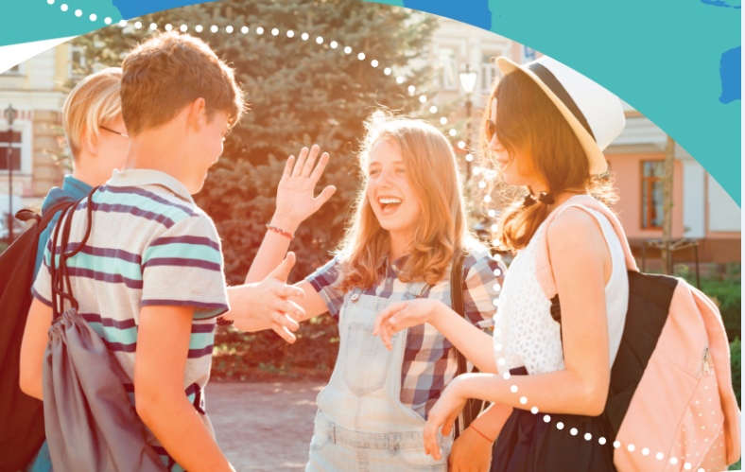


UNIT 5: Where I live
Street party

Slide 2
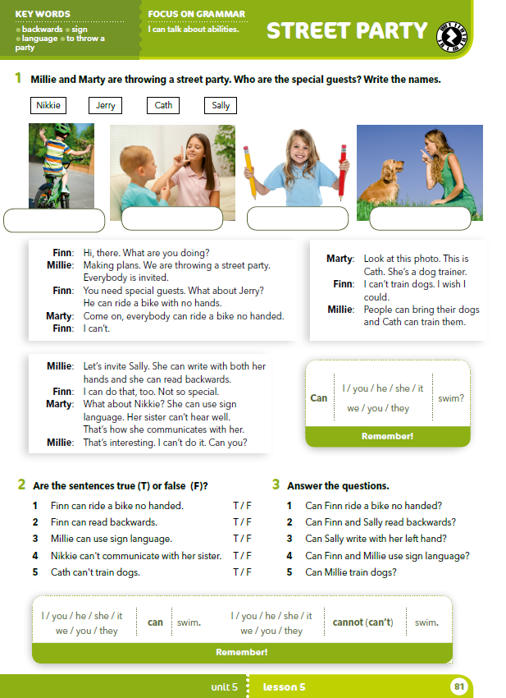
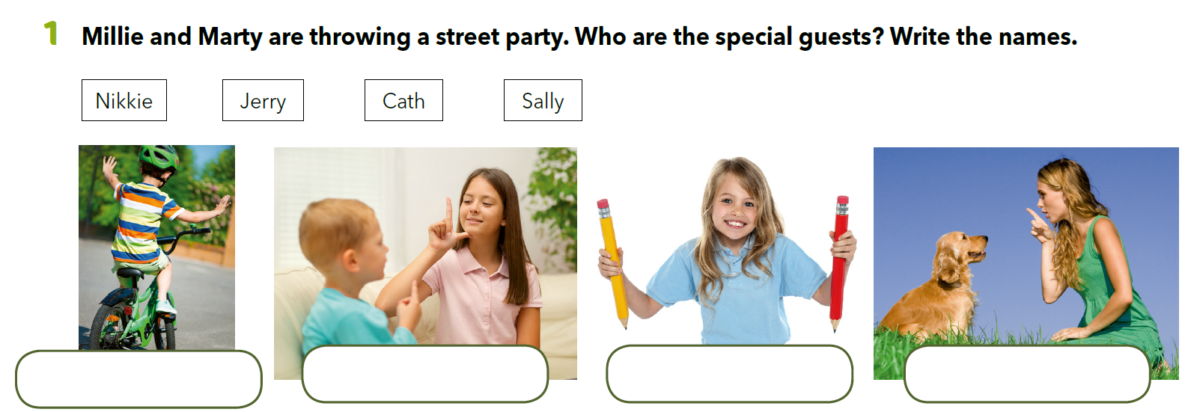
Look at the photos. What can you see?

Slide 3
What do you like about the festivals you presented?
What’s the most interesting one and why?
What kind of a party is a good party?
What do you need to have a party?

Slide 4
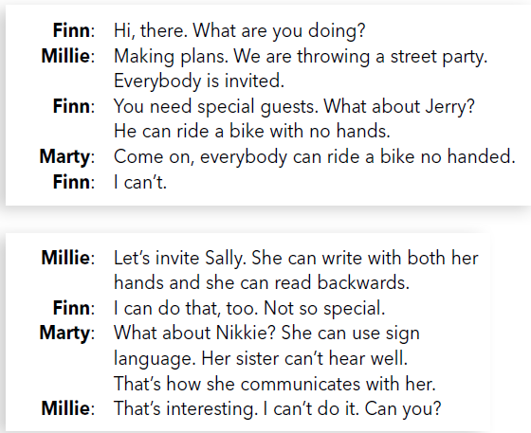
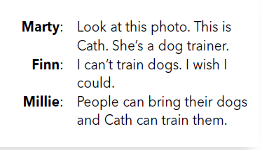
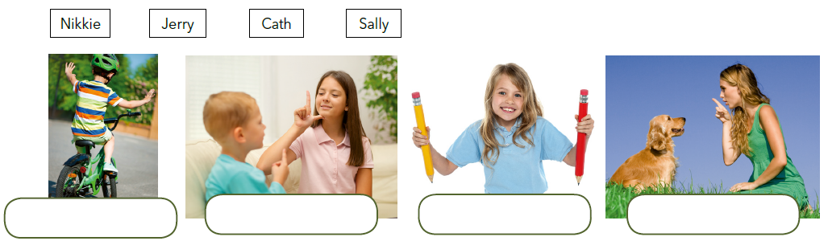
Translate
to throw a party –
backwards –
sign language –
ride a bike no handed -
Read the texts and write the names under the correct picture.
organizirati tulum
unatrag, unazad
Read the dialogues out loud.
znakovni jezik
voziti bicikl bez korištenja ruku
Jerry
Nikkie
Sally
Cath

Slide 5
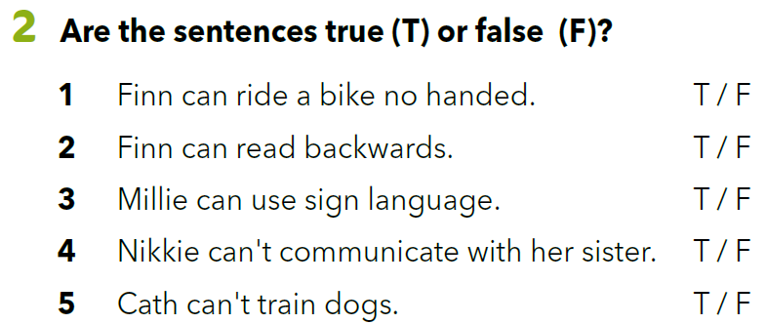

Slide 6


Close your book. Answer the following questions.

Slide 7
Look at the examples. Translate.
Nakon „can” slijedi infinitiv glagola.
I can swim.
He can ride a bike.
Sally can write with her left hand.
They can speak English.
Ja znam plivati.
On zna voziti bicikl.
Sally može pisati lijevom rukom.
Oni znaju pričati engleski jezik.
can = moći, znati

Slide 8
I can swim. →
He can ride a bike. →
Sally can write with her left hand. →
They can speak English. →
I cannot (can’t) swim.
He cannot (can’t) ride a bike.
Sally cannot (can’t) write with her left hand.
They cannot (can’t) speak English.

Slide 9
I can swim. →
He can ride a bike. →
Sally can write with her left hand. →
They can speak English. →
Can I swim?
Can he ride a bike?
Can Sally write with her left hand?
Can they speak English?

Slide 10
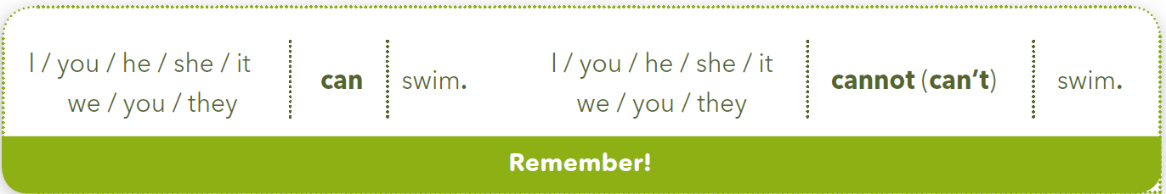
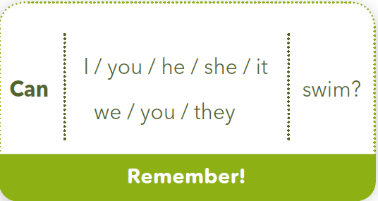

Slide 11
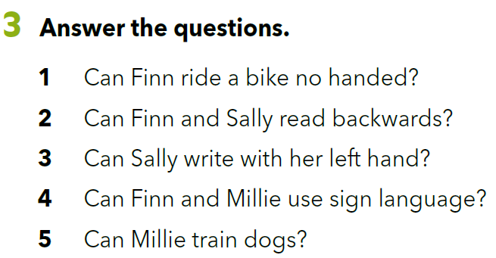
What can you do? What can’t you do?
Discuss with your teacher and other classmates.
https://wordwall.net/resource/260147/what-can-you-do-what-cant-you-do-discuss-your-teacher-or-friends

Slide 12
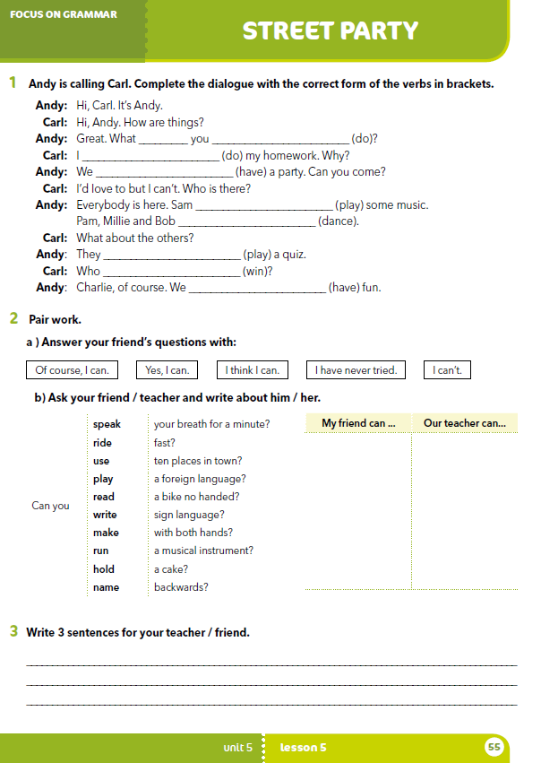
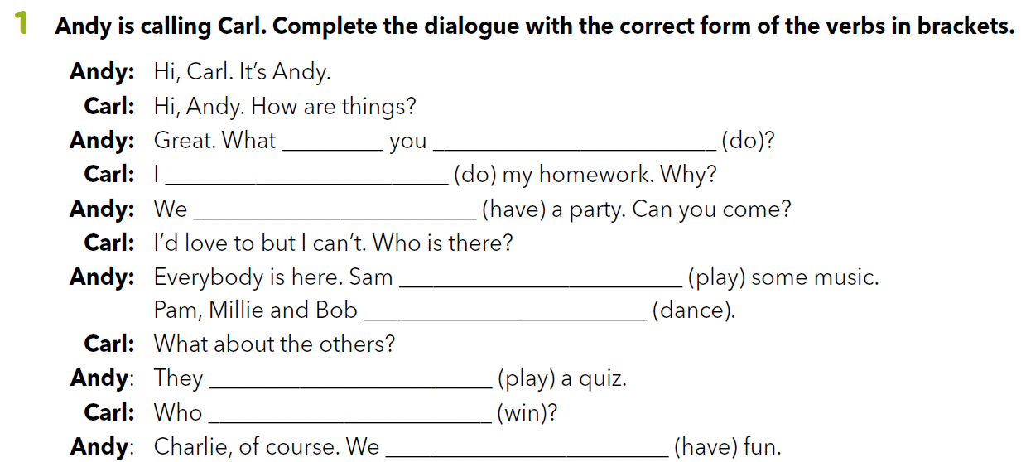
workbook p. 55
are
doing
am doing
are having
is playing
are dancing
are playing
is winnng
are having

Slide 13
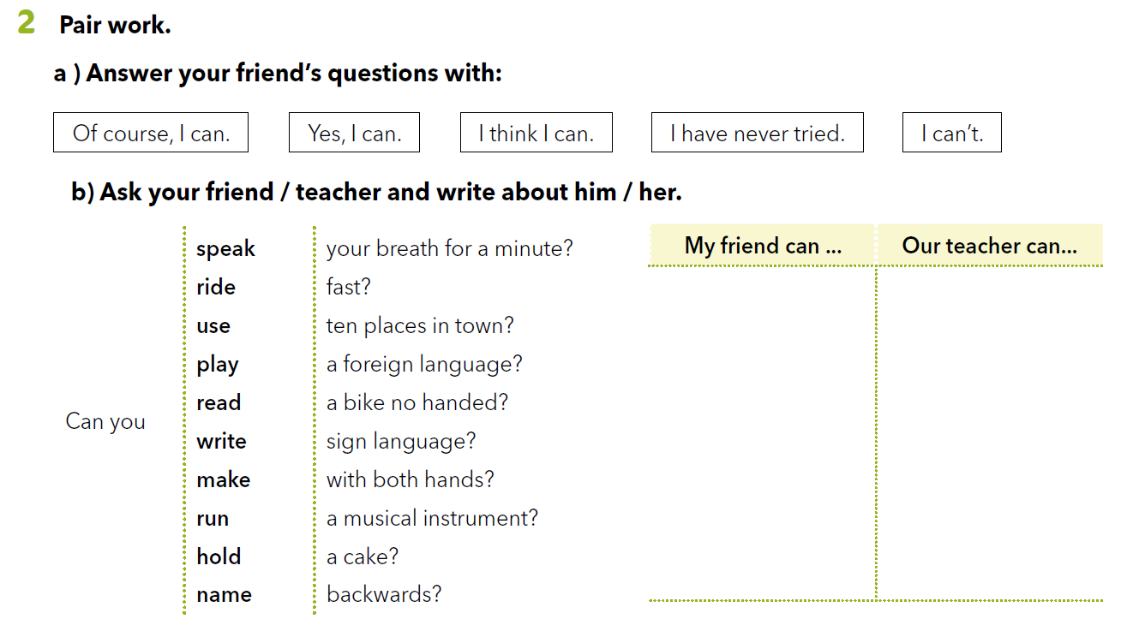
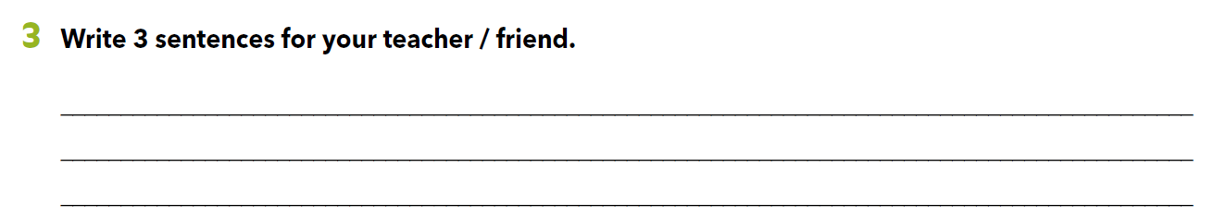
Mogu/Znam, naravno. Da, mogu/znam. Nisam nikad probao.

